Slide 1
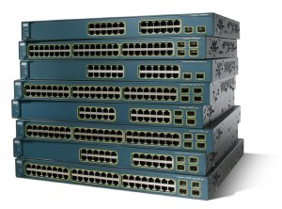


Welcome NET Students!
Graduating class of 2027!
September 5th, 2023
Presented by: Marc St-Hilaire, Ph.D, SMIEEE
Sherif Toulan, P.Eng., M.Eng., CCIE#4220

Slide 2



Welcome!
You are now a student in the NET program, with exceptionally high industry demand and fast-paced careers!
You are also a student with full-time status at both
Carleton University (CU) and Algonquin College (AC).
Note that while the program is joint, Carleton and Algonquin remain separate entities - ensure you’re set-up and familiar with both

Slide 3

Who are we…
Marc St-Hilaire:
  Carleton’s BIT‐NET Academic Coordinator
  Upper-year networking professor
  Researcher: Planning and design of computer networks
  Email: marc_st_hilaire@carleton.ca
Sherif Toulan:
  Algonquin’s BIT‐NET Academic Coordinator
  Upper-year networking professor
  Coordinator of Algonquin’s Cisco Networking Academy
  Email: toulans@algonquincollege.com
Where to find contact information: BITDegree.ca
Notes:
Sherif Toulan, P.Eng., M.Eng., PMP, CCIE # 4220 (R&S)
Professor, Algonquin College, BIT-NET Coordinator
Information and Communications Technology Dept.
toulans@algonquincollege.com

Slide 4

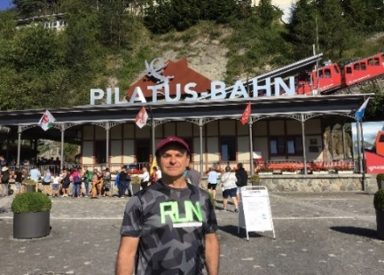





Sherif Toulan, Bio
Professional Engineers Ontario, P. Eng.# 90291410
M. Eng. Degree in Electrical Engineering from University of Toronto, 1991
Cisco Certified Internetwork Expert, CCIE# 4220, Routing & Switching, 1998
Cisco Certified Networking Professional, CCNP, 2020
Project Management Professional, PMP# 511073
August 12th, 2019- Present
Professor, Algonquin College, BIT NET Program Coordinator
2000 – Dec. 21st, 2018
Employed by Cisco Systems Canada as Network Design Engineer, working with key Service Providers (Bell Canada, at&t, France Telecom to deploy MPLS technologies)
1990-2000
Employed by Bell Canada as Network Consulting Engineer designing networks for Service Providers & Enterprise Customers (Banks, Insurance companies,…etc.)

Slide 5
When should you contact us?
First point of contact for any issues
  For registration issues, time conflicts, etc., please contact:
    CSIT-UG-Advising@cunet.carleton.ca
  For issues concerning a specific course, see prof first
Email is our preferred way of communication
As much as possible, try to set an appointment via email. This will allow to prepare as needed…
Schedule for Marc St-Hilaire:
  Tue: 9:00-10:00am
  Or any other time by appointment (in person or via MS Teams/Zoom)
Schedule for Sherif Toulan:
  Office hours (Tuesday(s): 10:00am—11:00am) or via Zoom

Slide 6
General Information
Most information can be found on www.bitdegree.ca
All academic administration is at Carleton
Course Registration (Online or Registrar’s Office)
  Overrides (i.e., restricted to program, lacking prerequisites)
  Conflicts (i.e., timetable)
Student Accounts
  Tuition Payments, Scholarships, Awards
Undergraduate Advice
  School of IT: Alison Jabi, Undergraduate Program Advisor (CSIT-UG-Advising@cunet.carleton.ca)

Slide 7
General Information
Carleton Campus Card:
  Collect from 407 University Centre
  Used to access labs/studios, Gym, Library, pay for food, etc.
  PIN is required (students.carleton.ca)
Algonquin:
            Proof of BIT student status from Algonquin’s Registrar’s Office required
            Use the Card Services website for all the information
              https://www.algonquincollege.com/parking/card-services/

Slide 8
What are the core courses & key prereq.
Core courses
  Used to calculate your Major CGPA
  Identified with a blue star on the next slide.
Although all courses are important, as first year students, you should pay more attention to the following courses:
  NET1001, fundamental & core computer basics course
  NET1002, fundamental & core networking course
Chains of prerequisites
  Pay close attention to the various chains of prerequisites.
  Failing a course may delay your studies by an entire year.
  The progression map (shown on the next slide) is your best tool to navigate through the program.
Course list available here
Progression map available here

Slide 9
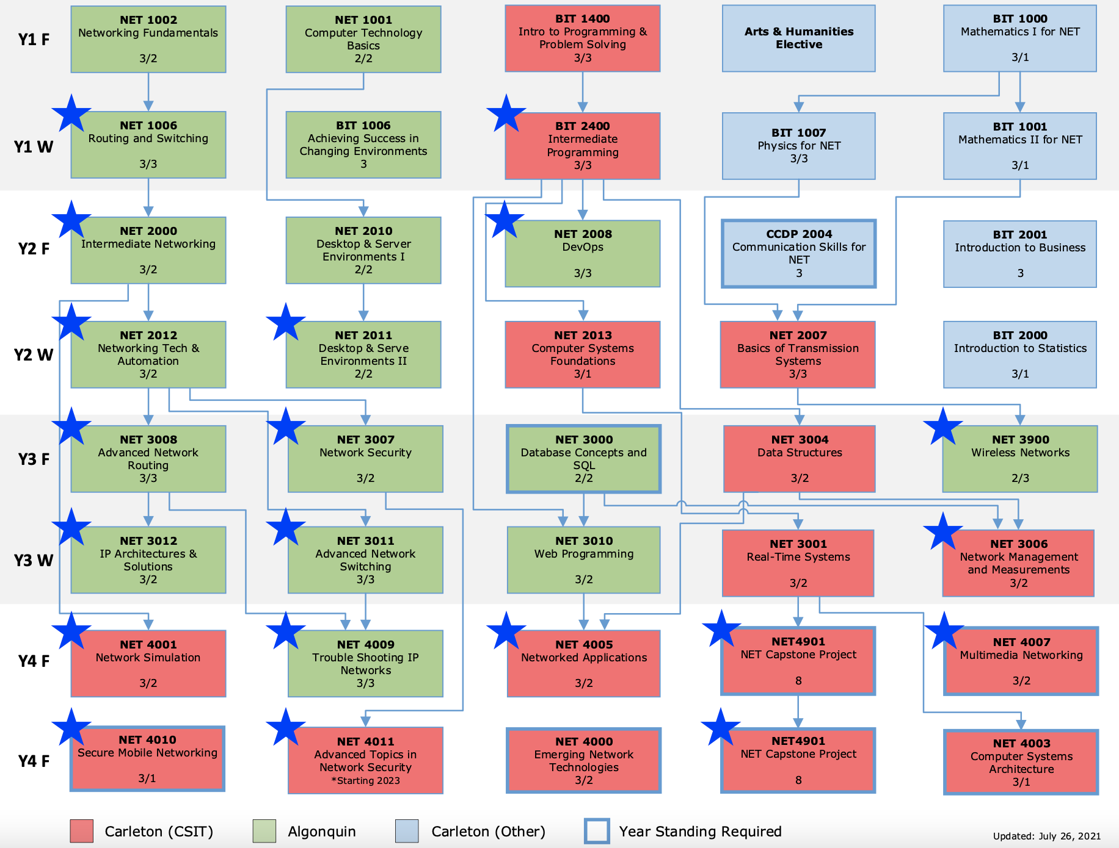
Progression Map

Slide 10
What are the lab sections for?
When do they start?
Labs = hands on
Several lab sections (section Ax) so that you have access to equipment and enjoy better prof:student ratios
Demo of alternate schedule
At Algonquin:
  Labs start on day 1 - unless specifically informed otherwise
  Labs & classes begin right on the hour (not 5 mins after the hour)
At Carleton:
  Labs do not usually start until the 2nd or 3rd week … Verify with each course instructor

Slide 11
Arts/Humanities electives
First elective in Fall of 1st year
Second elective (BIT 1006) in Winter of 1st year
BIT 1006 “Achieving Success in Changing Environments” Single Elective course
  Helps to explore possibilities ahead, assesses your aptitude and strengths
  Applies critical thinking and decision-making tools to help resolve some of the important society complex issues
No prerequisite for BIT1006, restricted to BIT NET students
You get registered in this course by default, this course at Algonquin is numbered as CST8300

Slide 12
Capstone Projects
In your 4th year, you will have to do an 8 month-long project (1 credit).
Opportunity to apply concepts and knowledge gained from previous courses
Done under the supervision of a faculty member
Project fair at the end of the year to showcase your work
Example of previous projects (changing every year):
  Cybersecurity of connected and autonomous vehicles
  Implementing network security applications in open-source SDN
  IoT application placement
  Smart home automation
  Cloud/Edge computing

Slide 13
Cisco, Industry Certifications & Cisco competitors
Through your 4-year program and studies, you will learn the basis of technologies that will enable you to work with multiple vendors.
Cisco is the largest networking company in the world, but you will learn also about Cisco competitors like Nokia, Juniper, Aruba, etc.
To pass Cisco certifications, you still need to write the official Cisco Certification exams.
Cisco certification Best practice:
  Write your certification exam as soon as you can, while the details are still fresh in your memory.
    Write your CCNA (200-301) after 2nd year course NET2012
    Write each CCNP test (300-410,350-401) shortly after completing the corresponding NET course(s) in 4th year, NET4009
Other Industry certifications like Juniper, Nokia, etc. can be attempted, you need to discuss with your professor for guidance.
Notes:
All costs are USD …
200-301 costs $325
CCNP exams are $400 each

Slide 14

Practical elements, Software & OS
What laptop do I need?
  No specific needs, but …
  A quad-core processor with 16GB RAM should be considered essential. Storage requirements at least 500 GB-1 TB, SSD (fast!) is a must.
In-Lab PCs are available at both campuses
Limited number of laptop loaners from Algonquin are available
There is no need to buy any specific software (most are free)
Most students choose to use their own laptop during the lectures and labs.
  Mac and PC
Both Linux and Windows OS will be taught and used in different courses
  Knowledge & skills are required for both OSs
Notes:
Microsoft Office (Free):
https://carleton.ca/its/ms-offer-students/
Microsoft Development (Free):
Visual Studio, Windows 10 OS, Microsoft Access, SQL Server
https://azureforeducation.microsoft.com/devtools
Other Licensed Software (Free or Discounted):
TrendMicro AntiVirus, Adobe Creative Suite, Matlab
https://carleton.ca/its/all-services/computers/site-licensed-software/

Slide 15
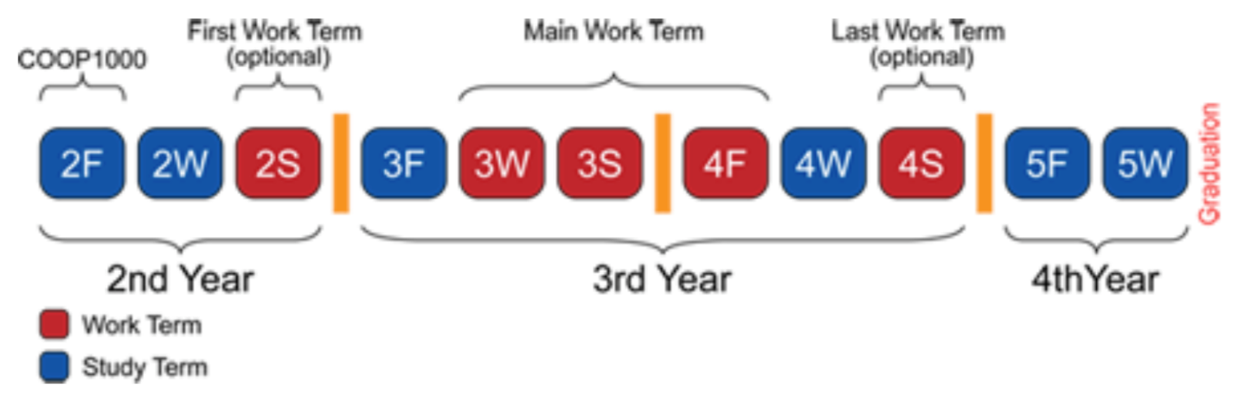
Co-op Program
As BIT NET students, a co-op option is available to you
Application at admission time or before the beginning of your second year through the Carleton Co-op website
Need to maintain an overall CGPA of 8.0+
More info on Coop available here

Slide 16
Working while studying & Care
You’re here to STUDY!
Need to balance between your part time work and your studies to ensure that you do not fall behind.
  Failing a course could delay you as much as a year! Seek help if you need!
Practical Labs are critical and need to be attended in person, need to coordinate with your employer to ensure that you do not miss labs.
If you have concerns that you need to discuss, always contact your Professor first.
The student success specialist (Algonquin) is available for your support and will guide you to which resource to contact depending on the nature of your concern.
“Remember, we are here to help you succeed”

Slide 17
Careers
BIT NET courses prepare you to join industry and work in different fields, i.e., Security, networking, computer programming, etc.
Typical employers of BIT NET students: Nokia, CENGEN, Shared Services Canada, Cisco, Facebook, Bell Canada, Telus, Google, etc.

Slide 18
Final Note
The high-ed experience is a wonderful time in your life!
Be sure to get involved in extra-curricular activities such as clubs, sports, BIT Society, and campus life!
We wish you the very best for a healthy, successful and safe terms.
Thank you

